Slide 1

SDE Readiness Training
Empowering Tomorrow’s Innovators

Slide 2

Module II
Data Structures for Software Development Engineers using Java

Slide 3

Introduction to Data Structures
Learning Level: Basic
Date: 01.07.2024

Slide 4

Relationship between Algorithm, Data Structure, and Program
Introduction to Data Structures
Can you explain the relationship between Algorithm, Data Structures, and Program?

Slide 5
Relationship between Algorithm, Data Structure, and Program
Introduction to Data Structures
Program = Algorithm + Data Structure
A computer is a tool that can be used to implement a plan for solving a problem.
A computer program is a set of instructions for a computer. These instructions describe the steps that the computer must follow to implement a plan.
An algorithm is a plan for solving a problem.
A person must design an algorithm.
A person must translate an algorithm into a computer program.

Slide 6
Algorithm – Recap
Introduction to Data Structures
An algorithm is a finite set of instructions that accomplishes a particular task.
In other words, an algorithm is a well-defined computational procedure in order to accomplishes a particular task.
It takes some value or a set of values as input and produces some value or a set of values as output.
Algorithm = Logic + Control

Slide 7
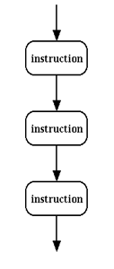
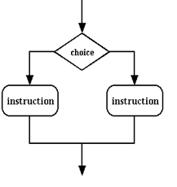
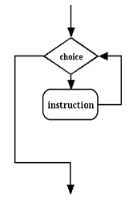
Algorithm - Recap
Introduction to Data Structures
Logic of the Problem
Algorithm = Logic + Control
Sequence
Selection
Looping

Slide 8
What is Data Structure?
Introduction to Data Structures
Data structure is a systematic way to organize data in computer memory so that it can be accessed and used efficiently.
In other words, Data Structure is the way of organizing, storing, and retrieving data and their relationship with each other.
There are several kinds of data structures like Array, stack, queue, linked list etc.
Each of them are suitable for specific type of tasks.

Slide 9
Classification
Introduction to Data Structures
Data Structures
Primitive
Non-Primitive
Integer
Real
Character
Boolean
Linear
Non-Linear
Arrays
Tree
Linked List
Graph
Stack
Queue

Slide 10
Classification
Introduction to Data Structures
Primitive data structure
Primary Data Structures or Primitive Data Structures are the basic data structures that directly operate upon the machine instructions.
Example: Integer, Floating point numbers, Character constants, String constants, Pointers.
Non-primitive data structure
Non primitive data structures or Secondary data structures are derived from one or more primitive data structures.
The objective of creating non-primitive data structures is to form sets of homogeneous or heterogeneous data elements.
It is categorized into two parts such as linear data structure and non-linear data structure.

Slide 11
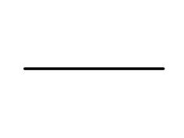
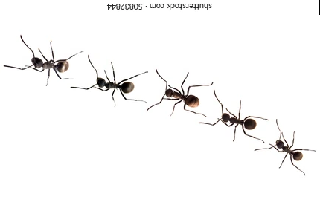
Classification
Introduction to Data Structures
Linear data structure
Linear data structure is a sequential type of data structure, and here sequential means that all the elements in the memory are stored in a sequential manner;
For example, element stored after the second element would be the third element, the element stored after the third element would be the fourth element and so on.
Linear data structures holding the sequential values such as Array, Linked list, Stack, Queue.
Ants go in line

Slide 12
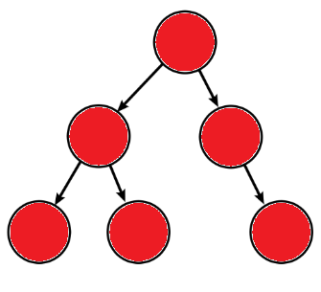
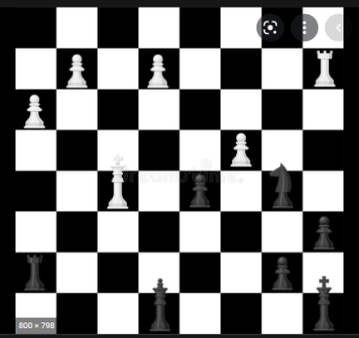
Classification
Introduction to Data Structures
Non-linear data structure
Non-linear data structure is a kind of random type of data structure.
The non-linear data structures are Tree and Graph.
Tree
Chess pieces move in random order

Slide 13
Abstract Data Type
Introduction to Data Structures
An abstract data type is an abstraction of a data structure that provides only the interface to which the data structure must adhere.
The interface does not give any specific details about something should be implemented or in what programming language.
The definition of ADT only mentions what operations are to be performed but not how these operations will be implemented.
It does not specify how data will be organized in memory and what algorithms will be used for implementing the operations.
It is called “abstract” because it gives an implementation-independent view.
The process of providing only the essentials and hiding the details is known as abstraction.

Slide 14
Abstract Data Type
Introduction to Data Structures
ADT is a collection of data together with a set of operations on that data.
ADT = Data + Operations
Definition :
Abstract Data type (ADT) is defined as a mathematical model with a collection of operations defined on that model.

Slide 15
Abstract Data Type
Introduction to Data Structures
For example, If we consider the smart phone.
We look at the high specifications of the smart phone, such as:
128 GB RAM, Snapdragon 8 generation processor
6.5 inch LCD screen, Dual camera, Android 11.0
The above specifications of the smartphone are the data, and we can also perform the following operations on the smartphone:
call(): We can call through the smartphone.
text(): We can text a message.
photo(): We can click a photo.
video(): We can also make a video.
The smartphone is an entity whose data or specifications and operations are given above. They are abstract and the implementation is hidden from user.

Slide 16
Abstract Data Type
Introduction to Data Structures
Simple ADTs
Predefined data types are Simple ADTs.
Example: int, float, double, char, bool
Consider Integer ADT:
This type of ADT is an integer with predefined ranges.
Several operations that can be applied to this data type (addition, subtraction, multiplication, division and so on)
Integer ADT
….. -3,-2,-1,0,1,2,3….
Integer ADT
Data
Number
Positive / Negative
Operations
Addition
Subtraction
Multiplication
Division

Slide 17
Abstract Data Type
Introduction to Data Structures
Complex ADT:
While several simple ADTs have been implemented, such as integer, real, character, pointer and so on, and are available for use in most languages, many useful complex ADTs are not.
We need some additional ADTs that should be created and stored in the library of the computer to be used.
Example: List, Set, Graph, Stack, Queue, etc.,

Slide 18
Designing of Algorithm
Introduction to Data Structures
In Computer Science, developing an algorithm is an art or skill.
And we can have mastery on algorithm development process only when we follow certain steps.
Before actual implementation of the program or problem, designing an algorithm is very important step.

Slide 19
Designing of Algorithm
Introduction to Data Structures
What are the steps that need to be followed while designing an algorithm?
Step 1: Understand the problem
Read the problem description carefully and ask questions for clarifying the doubts about the problem.
To find out what are the necessary inputs for solving that problem.
The input to the algorithm is called instance of the problem.
To decide the range of inputs so that the boundary values of algorithm get fixed
The algorithm should work correctly for all valid inputs.
Identify the strength and weakness of existing algorithm to refine and improve.

Slide 20
Designing of Algorithm
Introduction to Data Structures
Step 2: Decision making on
Capabilities of computational device
Essential to have proper choice of a computational device which is space and time efficient.
For Example the sequential and parallel algorithms are need different kinds of computational devices.
Choice for either exact or approximate problem solving method
Choice of Data structures
Data Structure and algorithm work together and these are interdependent. The choice of proper data structure is required before designing the actual algorithm.

Slide 21
Relationship between Algorithm, Data Structure, and Program
Introduction to Data Structures
What is the relationship between Algorithm, Data Structures, and Program?
The implementation of any program is possible with the help of algorithm and data structure.
Program = Data Structures + Algorithm

Slide 22
Designing of Algorithm
Introduction to Data Structures
Choice of Algorithm strategies
It is a general approach by which many problems can be solved algorithmically
Some of the algorithm strategies:-
Brute force
Divide – and – Conquer
Greedy Techniques
Dynamic Programming
Back Tracking
Branch and bound
Etc.,

Slide 23
Designing of Algorithm
Introduction to Data Structures
Step 3: Specification of algorithm
There are various ways by which we can specify an algorithm
Using natural language
Pseudo code
Flowchart
Step 4: Algorithmic verification
It means checking correctness of an algorithm
Normally check whether the algorithm gives correct output in finite amount of times for a valid set of input

Slide 24
Designing of Algorithm
Introduction to Data Structures
Step 5: Analysis of algorithm
While analyzing an algorithm we should consider following factors :-
Time efficiency of an algorithm: It means the amount of time taken by an algorithm to run. By computing time complexity we come to know whether the algorithm is slow or fast.
Space efficiency of an algorithm: It means the amount of space (memory ) taken by an algorithm. By computing space complexity we can analyze whether an algorithm requires more or less space.
Step 6: Implementation or coding of algorithm
It is done by suitable programming languages like C++ and JAVA.

Slide 25
Which Data Structure and Algorithm is better?
Introduction to Data Structures
How to decide which Data Structure and Algorithm is better?
Must meet requirements
High Performance
Low RAM footprint
Easy to implement

Slide 26

Quiz
Introduction to Data Structures
1) Which of the following best describes a data structure?
a) A method for analyzing algorithms
b) A systematic way to organize, store, and retrieve data in computer memory efficiently
c) A technique for debugging code
d) A programming paradigm focused on object-oriented design
Answer : b)

Slide 27
Quiz
Introduction to Data Structures
2) When analyzing an algorithm, which two factors are primarily considered to determine its efficiency?
a) Code readability and documentation
b) Input size and output size
c) Time efficiency and space efficiency
d) Compilation time and execution time
Answer : c)

Slide 28
Quiz
Introduction to Data Structures
3) Which statement describes an ADT?
a) An ADT specifies how data will be organized in memory and the algorithms used for operations
b) An ADT defines only the operations to be performed, without specifying how they will be implemented or in which programming language
c) An ADT is a specific data structure implementation in a particular programming language.
d) An ADT includes both the interface and the detailed implementation of data operations.
Answer : b)

Slide 29
Quiz
Introduction to Data Structures
4) Which data structure is categorized as a non-linear data structure?
a) Array
b) Linked List
c) Tree
d) Queue
Answer : c)

Slide 30
Quiz
Introduction to Data Structures
5) Non-primitive data structures are derived from:
a) Machine instructions
b) Compiler optimizations
c) Operating system commands
d) Primitive data structures
Answer : d)

Slide 31

Success is nothing more than a few straightforward disciplines put into daily practice.

